Slide 1
EMAS PERIODIC TABLE APP
By Josh, Sharlene, Finn, Andrei & Kshitij

Slide 2
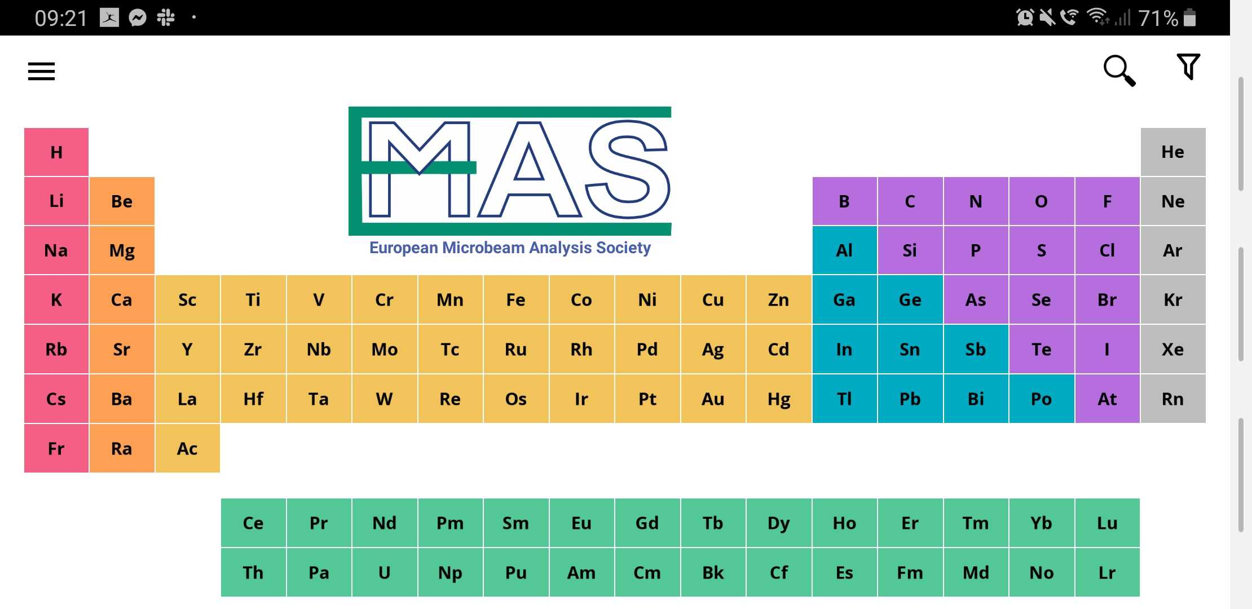
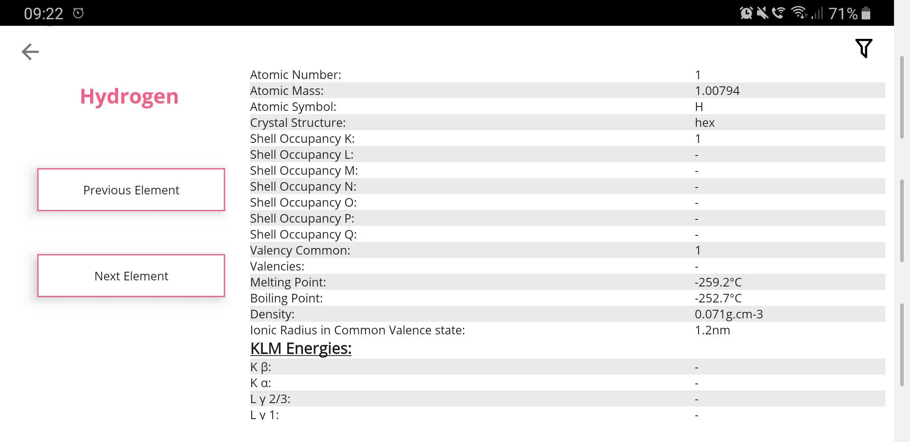
DEMONSTRATION
What can our app do?
Search
Filter by machine/crystals
Animated menu
Advanced periodic table data
Change units of energy values

Slide 3
Key aims & objectives
Build a fully functional periodic table with no glaring bugs
Implement a search features that works smoothly with the original design
Provide an easy to understand design, that one can use from the first time they have opened the app
Give as many people as possible the opportunity to access the application

Slide 4
WHAT WE HAVE ACHIEVED
Lets take a little journey…

Slide 5
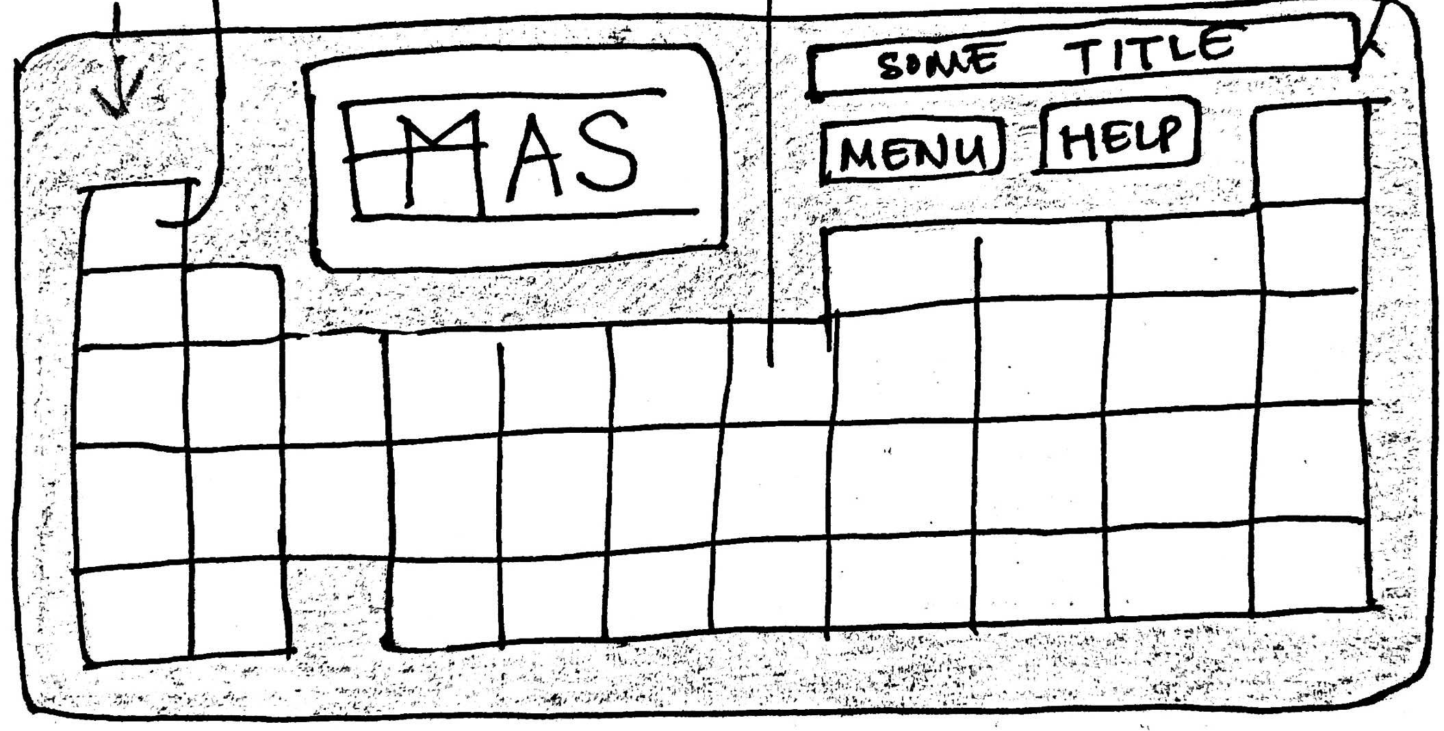
INITIAL DESIGN
We started with the following ideas:
Dark background with colourful buttons
Logo in the top centre
Buttons for menu, help in the top right

Slide 6
MVP RELEASE
Most of the features on the app were simply images. The buttons, however, were functional and lead to the respective element page.

Slide 7
In this version we had finalized our theme for the UI, and implement most of the features required.
BETA RELEASE

Slide 8
FINAL RELEASE
What do you think?

Slide 9
So what did we achieve?
We built our first ever app!
We learned how to work as a team and with a client
Working through other deadlines
Technically:
Better understanding of software engineering and agile development process
Increased knowledge of OOP
Comfortable with using git
XML Masters
The design process and constructing an intuitive UI

Slide 10
CHALLENGES WE FACED:
Android studio – lots of resources, easy to get lost at the start
How to distribute the work, but then we got the hang of it
Understanding the chemistry
Implementing continuous deployment

Slide 11
Things we’d do differently
Make tasks smaller and set smaller goals
Track meetings better with Open Project
Implement CircleCI earlier on
Use the Flutter framework to extend our app to the iOS store
Try to understand the chemistry earlier on

Slide 12
Overall things we’ve learned
How to effectively work in a team
How to distribute work fairly
Co-operative problem solving
How to use android studio
How to implement a static SQLite database in android studio
How to implement a continuous integration strategy
Worked according to the agile manifesto

Slide 13
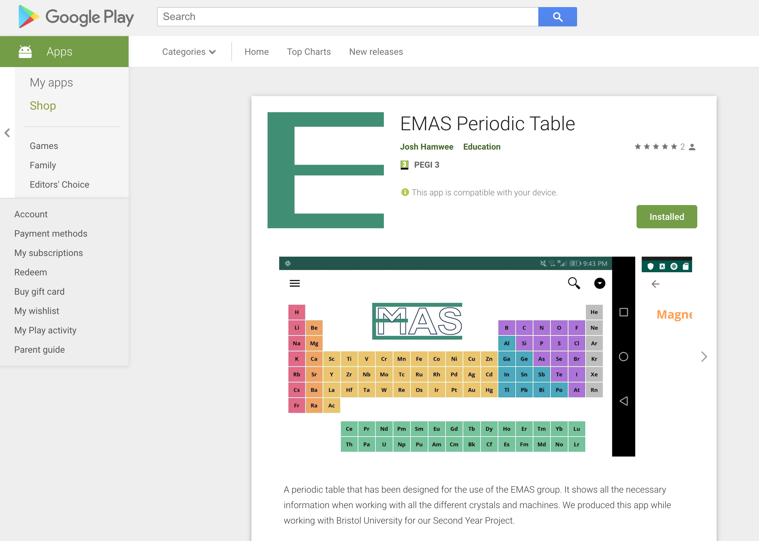
The app is live on the Play Store
DOWNLOAD THE APP NOW!!!

